Slide 1

Mining Association Rules
Data Mining

Slide 2
What Is Association Mining?
Association rule mining:
  Finding frequent patterns, associations, correlations, or causal structures among sets of items or objects in transaction databases, relational databases, and other information repositories.
Applications:
  Basket data analysis, cross-marketing, catalog design, loss-leader analysis, clustering, classification, etc.
Examples.
  Rule form: “Body → Ηead [support, confidence]”.
  buys(x, “diapers”) → buys(x, “beers”) [0.5%, 60%]
  major(x, “CS”) ^ takes(x, “DB”) → grade(x, “A”) [1%, 75%]
Data Mining

Slide 3
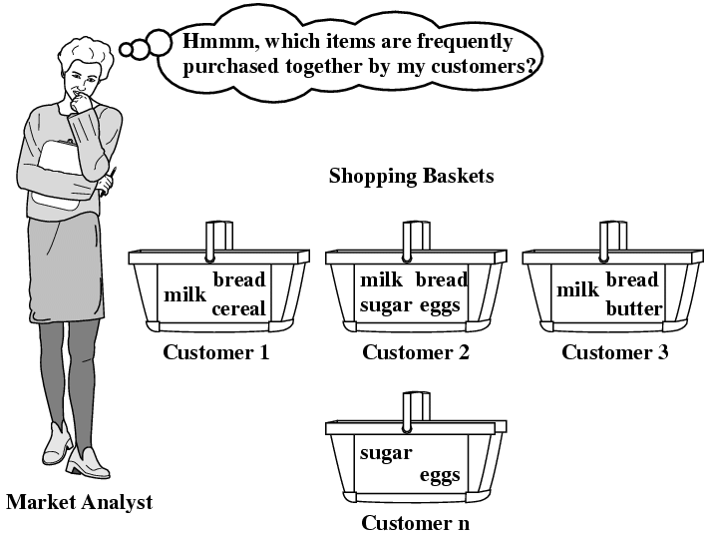
Market Basket Analysis
Typically, association rules are considered interesting if they satisfy both a minimum support threshold and a minimum confidence threshold.
Data Mining

Slide 4
Association Rule: Basic Concepts
Given: (1) database of transactions, (2) each transaction is a list of items (purchased by a customer in a visit)
Find: all rules that correlate the presence of one set of items with that of another set of items
  E.g., 98% of people who purchase tires and auto accessories also get automotive services done
Applications
  * ⇒ Maintenance Agreement (What the store should do to boost Maintenance Agreement sales)
  Home Electronics ⇒ * (What other products should the store stocks up?)
Data Mining

Slide 5
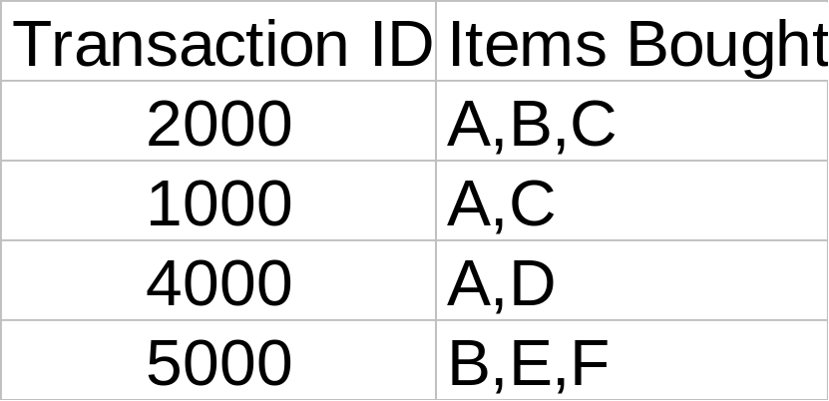
Rule Measures: Support and Confidence
Customer
buys both
Customer
buys diaper
Find all the rules X & Y ⇒ Z with minimum confidence and support
  support, s, probability that a transaction contains {X & Y & Z}
  confidence, c, conditional probability that a transaction having {X & Y} also contains Z
Customer
buys beer
Let minimum support 50%, and minimum confidence 50%, we have
  A ⇒ C (50%, 66.6%)
  C ⇒ A (50%, 100%)
Data Mining

Slide 6

Association Rule Mining
Given a set of transactions, find rules that will predict the occurrence of an item based on the occurrences of other items in the transaction
Market-Basket transactions
Example of Association Rules
{Diaper} → {Beer},
{Milk, Bread} → {Eggs,Coke},
{Beer, Bread} → {Milk},
Implication means co-occurrence, not causality!
Data Mining

Slide 7

Definition: Frequent Itemset
Itemset
  A collection of one or more items
    Example: {Milk, Bread, Diaper}
  k-itemset
    An itemset that contains k items
Support count (σ)
  Frequency of occurrence of an itemset
  E.g. σ({Milk, Bread, Diaper}) = 2
Support
  Fraction of transactions that contain an itemset
  E.g. s({Milk, Bread, Diaper}) = 2/5
Frequent Itemset
  An itemset whose support is greater than or equal to a minsup threshold

Slide 8



Definition: Association Rule
Association Rule
  An implication expression of the form X → Y, where X and Y are itemsets
  Example:
  {Milk, Diaper} → {Beer}
Rule Evaluation Metrics
  Support (s)
    Fraction of transactions that contain both X and Y
  Confidence (c)
    Measures how often items in Y
    appear in transactions that
    contain X
Example:
Data Mining

Slide 9
Association Rule Mining Task
Given a set of transactions T, the goal of association rule mining is to find all rules having
  support ≥ minsup threshold
  confidence ≥ minconf threshold
Brute-force approach:
  List all possible association rules
  Compute the support and confidence for each rule
  Prune rules that fail the minsup and minconf thresholds
  ⇒ Computationally prohibitive!
Data Mining

Slide 10
Mining Association Rules
Example of Rules:
{Milk,Diaper} → {Beer} (s=0.4, c=0.67)
{Milk,Beer} → {Diaper} (s=0.4, c=1.0)
{Diaper,Beer} → {Milk} (s=0.4, c=0.67)
{Beer} → {Milk,Diaper} (s=0.4, c=0.67)
{Diaper} → {Milk,Beer} (s=0.4, c=0.5)
{Milk} → {Diaper,Beer} (s=0.4, c=0.5)
Observations:
All the above rules are binary partitions of the same itemset:
{Milk, Diaper, Beer}
Rules originating from the same itemset have identical support but
can have different confidence
Thus, we may decouple the support and confidence requirements
Data Mining

Slide 11
Mining Association Rules
Two-step approach:
  Frequent Itemset Generation
    Generate all itemsets whose support ≥ minsup
  Rule Generation
    Generate high confidence rules from each frequent itemset, where each rule is a binary partitioning of a frequent itemset
Frequent itemset generation is still computationally expensive
Data Mining

Slide 12

Frequent Itemset Generation
Given d items, there are 2^{d} possible candidate itemsets
Data Mining

Slide 13

Frequent Itemset Generation
Brute-force approach:
  Each itemset in the lattice is a candidate frequent itemset
  Count the support of each candidate by scanning the database
  Match each transaction against every candidate
  Complexity ~ O(NMw) => Expensive since M = 2^{d} !!!
Data Mining

Slide 14
Frequent Itemset Generation Strategies
Reduce the number of candidates (M)
  Complete search: M=2^{d}
  Use pruning techniques to reduce M
Reduce the number of transactions (N)
  Reduce size of N as the size of itemset increases
Reduce the number of comparisons (NM)
  Use efficient data structures to store the candidates or transactions
  No need to match every candidate against every transaction
Data Mining

Slide 15
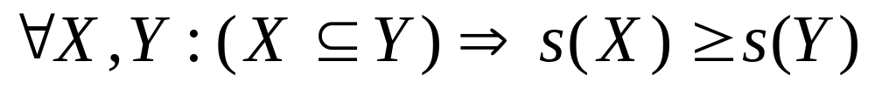
Reducing Number of Candidates
Apriori principle:
  If an itemset is frequent, then all of its subsets must also be frequent
Apriori principle holds due to the following property of the support measure:
  Support of an itemset never exceeds the support of its subsets
  This is known as the anti-monotone property of support
Data Mining

Slide 16


Illustrating Apriori Principle
Found to be Infrequent
Pruned supersets
Data Mining

Slide 17

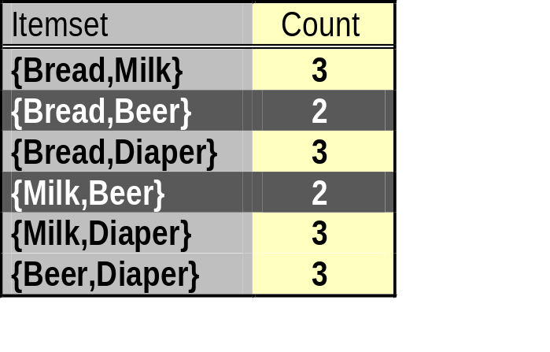
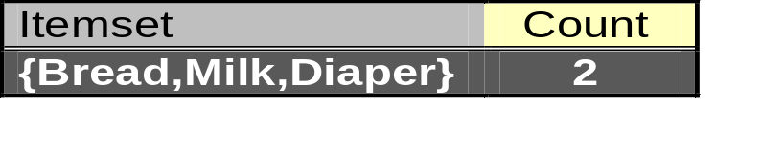
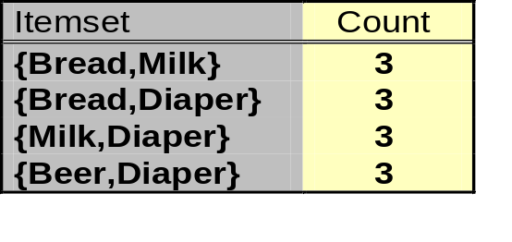
Illustrating Apriori Principle
Items (1-itemsets)
Pairs (2-itemsets)
(No need to generate
candidates involving Coke
or Eggs)
Minimum Support = 3
Triplets (3-itemsets)
If every subset is considered,
⁶C₁ + ⁶C₂ + ⁶C₃ = 41
With support-based pruning,
6 + 6 + 1 = 13
Data Mining

Slide 18
The Apriori Algorithm
Join Step: C_{k} is generated by joining L_{k-1}with itself
Prune Step: Any (k-1)-itemset that is not frequent cannot be a subset of a frequent k-itemset
Pseudo-code:
    C_{k}: Candidate itemset of size k
    L_{k} : frequent itemset of size k
    L₁ = {frequent items};
    for (k = 1; L_{k} !=∅; k++) do begin
    C_{k+1} = candidates generated from L_{k};
    for each transaction t in database do
      increment the count of all candidates in C_{k+1} that are contained in t
    L_{k+1} = candidates in C_{k+1} with min_support
    end
    return ∪_{k} L_{k};
Data Mining

Slide 19








The Apriori Algorithm — Example
Database D
L₁
C₁
Scan D
C₂
C₂
L₂
Scan D
C₃
Scan D
L₃
Data Mining

Slide 20
How to Generate Candidates?
Suppose the items in L_{k-1} are listed in an order
Step 1: self-joining L_{k-1}
insert into C_{k}
select p.item₁, p.item₂, …, p.item_{k-1}, q.item_{k-1}
from L_{k-1} p, L_{k-1} q
where p.item₁=q.item₁, …, p.item_{k-2}=q.item_{k-2}, p.item_{k-1} < q.item_{k-1}
Step 2: pruning
  forall itemsets c in C_{k} do
    forall (k-1)-subsets s of c do
      if (s is not in L_{k-1}) then delete c from C_{k}
Data Mining

Slide 21
Example of Generating Candidates
L₃={abc, abd, acd, ace, bcd}
Data Mining

Slide 22
Example of Generating Candidates
L₃={abc, abd, acd, ace, bcd}
Self-joining: L₃*L₃
  abcd from abc and abd
  acde from acd and ace
Data Mining

Slide 23
Example of Generating Candidates
L₃={abc, abd, acd, ace, bcd}
Self-joining: L₃*L₃
  abcd from abc and abd
  acde from acd and ace
Pruning:
  acde is removed because ade is not in L₃
C₄={abcd}
Data Mining

Slide 24
How to Count Supports of Candidates?
Why counting supports of candidates a problem?
  The total number of candidates can be very huge
  One transaction may contain many candidates
Method:
  Candidate itemsets are stored in a hash-tree
  Leaf node of hash-tree contains a list of itemsets and counts
  Interior node contains a hash table
  Subset function: finds all the candidates contained in a transaction
Data Mining

Slide 25
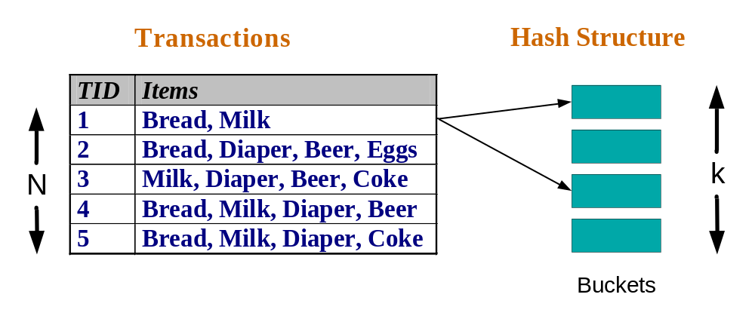
Reducing Number of Comparisons
Candidate counting:
  Scan the database of transactions to determine the support of each candidate itemset
  To reduce the number of comparisons, store the candidates in a hash structure
    Instead of matching each transaction against every candidate, match it against candidates contained in the hashed buckets
Data Mining

Slide 26
Generate Hash Tree
Suppose you have 15 candidate itemsets of length 3:
{1 4 5}, {1 2 4}, {4 5 7}, {1 2 5}, {4 5 8}, {1 5 9}, {1 3 6}, {2 3 4}, {5 6 7}, {3 4 5}, {3 5 6}, {3 5 7}, {6 8 9}, {3 6 7}, {3 6 8}
You need:
Hash function
Max leaf size: max number of itemsets stored in a leaf node (if number of candidate itemsets exceeds max leaf size, split the node)
Hash function
3,6,9
2 3 4
5 6 7
1,4,7
2,5,8
1 4 5
3 4 5
3 5 6
3 5 7
6 8 9
3 6 7
3 6 8
1 3 6
1 2 4
4 5 7
1 2 5
4 5 8
1 5 9

Slide 27
Association Rule Discovery: Hash tree
Hash Function
Candidate Hash Tree
1,4,7
3,6,9
2,5,8
2 3 4
5 6 7
1 4 5
1 3 6
3 4 5
3 5 6
3 6 7
Hash on 1, 4 or 7
3 5 7
3 6 8
1 2 4
1 5 9
6 8 9
1 2 5
4 5 7
4 5 8
Data Mining

Slide 28
Association Rule Discovery: Hash tree
Hash Function
Candidate Hash Tree
1,4,7
3,6,9
2,5,8
2 3 4
5 6 7
1 4 5
1 3 6
3 4 5
3 5 6
3 6 7
Hash on 2, 5 or 8
3 5 7
3 6 8
1 2 4
1 5 9
6 8 9
1 2 5
4 5 7
4 5 8
Data Mining

Slide 29
Association Rule Discovery: Hash tree
Hash Function
Candidate Hash Tree
1,4,7
3,6,9
2,5,8
2 3 4
5 6 7
1 4 5
1 3 6
3 4 5
3 5 6
3 6 7
Hash on 3, 6 or 9
3 5 7
3 6 8
1 2 4
1 5 9
6 8 9
1 2 5
4 5 7
4 5 8
Data Mining

Slide 30
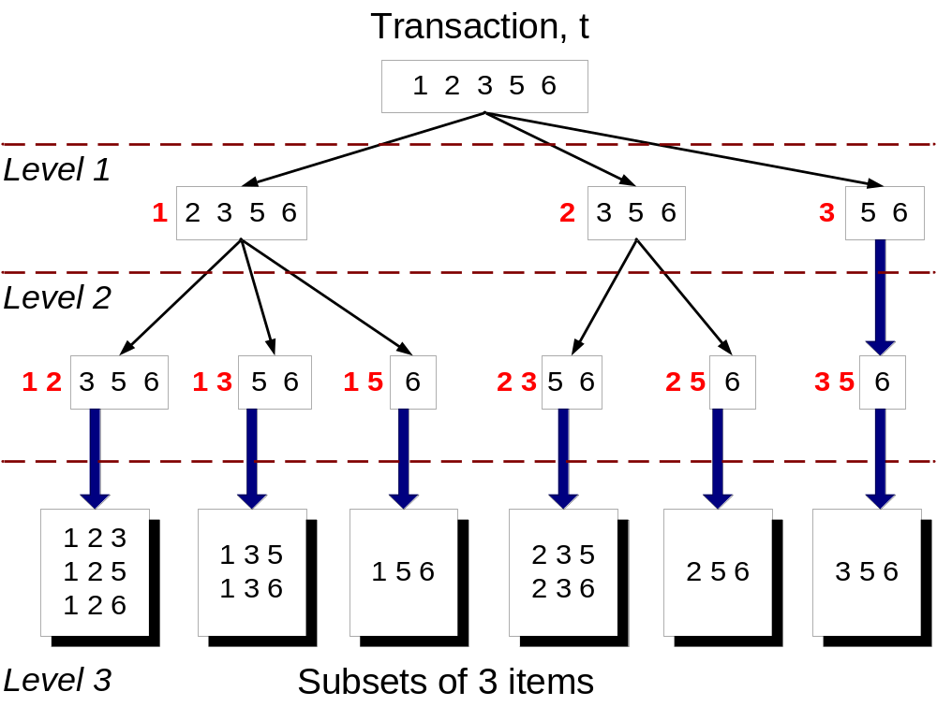
Subset Operation
Given a transaction t, what are the possible subsets of size 3?
Data Mining

Slide 31
Subset Operation Using Hash Tree
1 2 3 5 6
transaction
Hash Function
1 +
2 3 5 6
2 +
3 5 6
1,4,7
3,6,9
3 +
5 6
2,5,8
2 3 4
5 6 7
1 4 5
1 3 6
3 4 5
3 5 6
3 6 7
3 5 7
3 6 8
1 2 4
1 2 5
1 5 9
6 8 9
4 5 7
4 5 8
Data Mining

Slide 32
Subset Operation Using Hash Tree
1 2 3 5 6
transaction
Hash Function
1 +
2 3 5 6
2 +
3 5 6
1,4,7
3,6,9
1 2 +
3 5 6
3 +
5 6
2,5,8
1 3 +
5 6
2 3 4
1 5 +
6
5 6 7
1 4 5
1 3 6
3 4 5
3 5 6
3 6 7
3 5 7
3 6 8
1 2 4
1 2 5
1 5 9
6 8 9
4 5 7
4 5 8
Data Mining

Slide 33
Subset Operation Using Hash Tree
1 2 3 5 6
transaction
Hash Function
1 +
2 3 5 6
2 +
3 5 6
1,4,7
3,6,9
1 2 +
3 5 6
3 +
5 6
2,5,8
1 3 +
5 6
2 3 4
1 5 +
6
5 6 7
1 4 5
1 3 6
3 4 5
3 5 6
3 6 7
3 5 7
3 6 8
1 2 4
1 2 5
1 5 9
6 8 9
4 5 7
4 5 8
Match transaction against 11 out of 15 candidates
Data Mining

Slide 34
Factors Affecting Complexity
Choice of minimum support threshold
  lowering support threshold results in more frequent itemsets
  this may increase number of candidates and max length of frequent itemsets
Dimensionality (number of items) of the data set
  more space is needed to store support count of each item
  if number of frequent items also increases, both computation and I/O costs may also increase
Size of database
  since Apriori makes multiple passes, run time of algorithm may increase with number of transactions
Average transaction width
  transaction width increases with denser data sets
  This may increase max length of frequent itemsets and traversals of hash tree (number of subsets in a transaction increases with its width)
Data Mining

Slide 35
Methods to Improve Apriori’s Efficiency
Hash-based itemset counting: A k-itemset whose corresponding hashing bucket count is below the threshold cannot be frequent
Transaction reduction: A transaction that does not contain any frequent k-itemset is useless in subsequent scans
Partitioning: Any itemset that is potentially frequent in DB must be frequent in at least one of the partitions of DB
Sampling: mining on a subset of given data, lower support threshold + a method to determine the completeness
Dynamic itemset counting: add new candidate itemsets only when all of their subsets are estimated to be frequent
Data Mining

Slide 36
Is Apriori Fast Enough? — Performance Bottlenecks
The core of the Apriori algorithm:
  Use frequent (k – 1)-itemsets to generate candidate frequent k-itemsets
  Use database scan and pattern matching to collect counts for the candidate itemsets
The bottleneck of Apriori: candidate generation
  Huge candidate sets:
    10⁴ frequent 1-itemset will generate 10⁷ candidate 2-itemsets
    To discover a frequent pattern of size 100, e.g., {a₁, a₂, …, a₁₀₀}, one needs to generate 2¹⁰⁰ ≈ 10³⁰ candidates.
  Multiple scans of database:
    Needs (n +1 ) scans, n is the length of the longest pattern
Data Mining

Slide 37
Mining Frequent Patterns Without Candidate Generation
Compress a large database into a compact, Frequent-Pattern tree (FP-tree) structure
  highly condensed, but complete for frequent pattern mining
  avoid costly database scans
Develop an efficient, FP-tree-based frequent pattern mining method
  A divide-and-conquer methodology: decompose mining tasks into smaller ones
  Avoid candidate generation: sub-database test only!
Data Mining

Slide 38
Construct FP-tree from a Transaction DB
TID Items bought (ordered) frequent items
100 {f, a, c, d, g, i, m, p} {f, c, a, m, p}
200 {a, b, c, f, l, m, o} {f, c, a, b, m}
300 {b, f, h, j, o} {f, b}
400 {b, c, k, s, p} {c, b, p}
500 {a, f, c, e, l, p, m, n} {f, c, a, m, p}
Min-support=3
{}
Steps:
Scan DB once, find frequent 1-itemset (single item pattern)
Order frequent items in frequency descending order
Scan DB again, construct FP-tree
Header Table
Item frequency head
f 4
c 4
a 3
b 3
m 3
p 3
f:4
c:1
c:3
b:1
b:1
a:3
p:1
m:2
b:1
Data Mining
p:2
m:1

Slide 39
Benefits of the FP-tree Structure
Completeness:
  never breaks a long pattern of any transaction
  preserves complete information for frequent pattern mining
Compactness
  reduce irrelevant information—infrequent items are gone
  frequency descending ordering: more frequent items are more likely to be shared
  never be larger than the original database (if not count node-links and counts)
Data Mining

Slide 40
Mining Frequent Patterns Using FP-tree
General idea (divide-and-conquer)
  Recursively grow frequent pattern path using the FP-tree
Method
  For each item, construct its conditional pattern-base, and then its conditional FP-tree
  Repeat the process on each newly created conditional FP-tree
  Until the resulting FP-tree is empty, or it contains only one path (single path will generate all the combinations of its sub-paths, each of which is a frequent pattern)
Data Mining

Slide 41
Step 1: From FP-tree to Conditional Pattern Base
Starting at the frequent header table in the FP-tree
Traverse the FP-tree by following the link of each frequent item
Accumulate all of transformed prefix paths of that item to form a conditional pattern base
Header Table
Item frequency head
f 4
c 4
a 3
b 3
m 3
p 3
{}
Conditional pattern bases
item cond. pattern base
c f:3
a fc:3
b fca:1, f:1, c:1
m fca:2, fcab:1
p fcam:2, cb:1
f:4
c:1
c:3
b:1
b:1
a:3
p:1
m:2
b:1
p:2
m:1
Data Mining

Slide 42
Properties of FP-tree for Conditional Pattern Base Construction
Node-link property
  For any frequent item a_{i} all the possible frequent patterns that contain a_{i} can be obtained by following a_{i}'s node-links, starting from a_{i}'s head in the FP-tree header
Prefix path property
  To calculate the frequent patterns for a node a_{i} in a path P, only the prefix sub-path of a_{i} in P need to be accumulated, and its frequency count should carry the same count as node a_{i}.
Data Mining

Slide 43
Step 2: Construct Conditional FP-tree
For each pattern-base
  Accumulate the count for each item in the base
  Construct the FP-tree for the frequent items of the pattern base
{}
m-conditional pattern base:
  fca:2, fcab:1
Header Table
Item frequency head
f 4
c 4
a 3
b 3
m 3
p 3
f:4
c:1
{}
All frequent patterns concerning m
m,
fm, cm, am,
fcm, fam, cam,
fcam
c:3
b:1
b:1

a:3
p:1
f:3

m:2
b:1
c:3
p:2
m:1
a:3
m-conditional FP-tree
Data Mining

Slide 44
Mining Frequent Patterns by Creating Conditional Pattern-Bases
Item
Conditional pattern-base
Conditional FP-tree
p
{(fcam:2), (cb:1)}
{(c:3)}|p
m
{(fca:2), (fcab:1)}
{(f:3, c:3, a:3)}|m
b
{(fca:1), (f:1), (c:1)}
Empty
a
{(fc:3)}
{(f:3, c:3)}|a
c
{(f:3)}
{(f:3)}|c
f
Empty
Empty
Data Mining

Slide 45
Step 3: Recursively mine the conditional FP-tree
{}
{}
Cond. pattern base of “am”: (fc:3)
f:3
c:3
f:3
am-conditional FP-tree
c:3
{}
Cond. pattern base of “cm”: (f:3)
a:3
f:3
m-conditional FP-tree
cm-conditional FP-tree
{}
Cond. pattern base of “cam”: (f:3)
f:3
cam-conditional FP-tree
Data Mining

Slide 46
Single FP-tree Path Generation
Suppose an FP-tree T has a single path P
The complete set of frequent pattern of T can be generated by enumeration of all the combinations of the sub-paths of P
{}
All frequent patterns concerning m
m,
fm, cm, am,
fcm, fam, cam,
fcam
f:3

c:3
a:3
m-conditional FP-tree
Data Mining

Slide 47
Principles of Frequent Pattern Growth
Pattern growth property
  Let α be a frequent itemset in DB, B be α's conditional pattern base, and β be an itemset in B. Then α ∪ β is a frequent itemset in DB iff β is frequent in B.
“abcdef ” is a frequent pattern, if and only if
  “abcde ” is a frequent pattern, and
  “f ” is frequent in the set of transactions containing “abcde ”
Data Mining

Slide 48
Why Is Frequent Pattern Growth Fast?
Our performance study shows
  FP-growth is an order of magnitude faster than Apriori
Reasoning
  No candidate generation, no candidate test
  Use compact data structure
  Eliminate repeated database scan
  Basic operation is counting and FP-tree building
Data Mining

Slide 49
Association Rules
Association rule R : Itemset1 => Itemset2
  Itemset1, 2 are disjoint and Itemset2 is non-empty
  meaning: if transaction includes Itemset1 then it also has Itemset2
Examples
  A,B => E,C
  A => B,C
Data Mining

Slide 50
From Frequent Itemsets to Association Rules
Q: Given frequent set {A,B,E}, what are possible association rules?
  A => B, E
  A, B => E
  A, E => B
  B => A, E
  B, E => A
  E => A, B
  __ => A,B,E (empty rule), or true => A,B,E

Slide 51
Rule Support and Confidence
Suppose R : I => J is an association rule
  sup (R) = sup (I ∪ J) is the support count
    support of itemset I ∪ J
  conf (R) = sup(R) / sup(I) is the confidence of R
    fraction of transactions with I ∪ J that have I
Association rules with minimum support and count are sometimes called “strong” rules
Data Mining

Slide 52
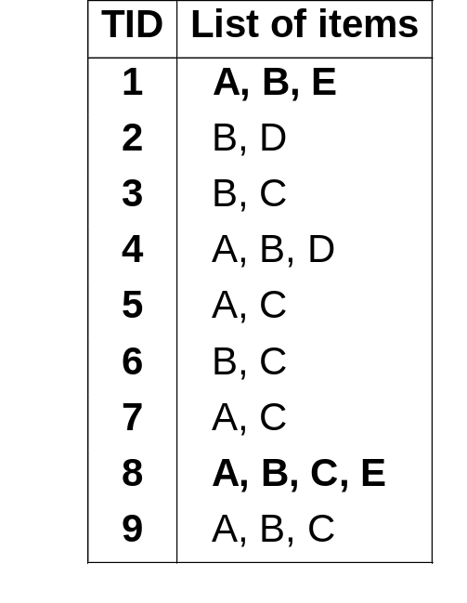
Association Rules Example
Q: Given frequent set {A,B,E}, what association rules have minsup = 2 and minconf= 50% ?
A, B => E : conf=2/4 = 50%

Slide 53
Association Rules Example
Q: Given frequent set {A,B,E}, what association rules have minsup = 2 and minconf= 50% ?
A, B => E : conf=2/4 = 50%
A, E => B : conf=2/2 = 100%
B, E => A : conf=2/2 = 100%
E => A, B : conf=2/2 = 100%
Don’t qualify
A =>B, E : conf=2/6 =33%< 50%
B => A, E : conf=2/7 = 28% < 50%
__ => A,B,E : conf: 2/9 = 22% < 50%

Slide 54
Find Strong Association Rules
A rule has the parameters minsup and minconf:
  sup(R) >= minsup and conf (R) >= minconf
Problem:
  Find all association rules with given minsup and minconf
First, find all frequent itemsets
Data Mining

Slide 55
Generating Association Rules
Two stage process:
  Determine frequent itemsets e.g. with the Apriori algorithm.
  For each frequent item set I
    for each subset J of I
      determine all association rules of the form: I-J => J
Main idea used in both stages : subset property
Data Mining

Slide 56
Weather Data: Play or not Play?
Outlook | Temperature | Humidity | Windy | Play?
sunny | hot | high | false | No
sunny | hot | high | true | No
overcast | hot | high | false | Yes
rain | mild | high | false | Yes
rain | cool | normal | false | Yes
rain | cool | normal | true | No
overcast | cool | normal | true | Yes
sunny | mild | high | false | No
sunny | cool | normal | false | Yes
rain | mild | normal | false | Yes
sunny | mild | normal | true | Yes
overcast | mild | high | true | Yes
overcast | hot | normal | false | Yes
rain | mild | high | true | No
Data Mining

Slide 57
Example: Generating Rules from an Itemset
Frequent itemset from golf data:
Seven potential rules:
Humidity = Normal, Windy = False, Play = Yes (4)
If Humidity = Normal and Windy = False then Play = Yes If Humidity = Normal and Play = Yes then Windy = False If Windy = False and Play = Yes then Humidity = Normal If Humidity = Normal then Windy = False and Play = Yes If Windy = False then Humidity = Normal and Play = Yes If Play = Yes then Humidity = Normal and Windy = False If True then Humidity = Normal and Windy = False and Play = Yes | 4/4 4/6 4/6 4/7 4/8 4/9 4/14
Data Mining

Slide 58
Rules for the weather data
Rules with support > 1 and confidence = 100%:
In total: 3 rules with support four, 5 with support three, and 50 with support two
 | Association rule |  | Sup. | Conf.
1 | Humidity=Normal Windy=False | ⇒Play=Yes | 4 | 100%
2 | Temperature=Cool | ⇒Humidity=Normal | 4 | 100%
3 | Outlook=Overcast | ⇒Play=Yes | 4 | 100%
4 | Temperature=Cold Play=Yes | ⇒Humidity=Normal | 3 | 100%
... | ... | ... | ... | ...
58 | Outlook=Sunny Temperature=Hot | ⇒Humidity=High | 2 | 100%
Data Mining

Slide 59
Filtering Association Rules
Problem: any large dataset can lead to very large number of association rules, even with reasonable Min Confidence and Support
Confidence by itself is not sufficient
  e.g. if all transactions include Z, then
  any rule I => Z will have confidence 100%.
Other measures to filter rules
Data Mining

Slide 60
Rule Generation
Given a frequent itemset L, find all non-empty subsets f ⊂ L such that f → L – f satisfies the minimum confidence requirement
  If {A,B,C,D} is a frequent itemset, candidate rules:
    ABC →D, ABD →C, ACD →B, BCD →A,
    A →BCD, B →ACD, C →ABD, D →ABC
    AB →CD, AC → BD, AD → BC, BC →AD,
    BD →AC, CD →AB,
If |L| = k, then there are 2^{k} – 2 candidate association rules (ignoring L → ∅ and ∅ → L)
Data Mining

Slide 61
Rule Generation
How to efficiently generate rules from frequent itemsets?
  In general, confidence does not have an anti-monotone property
    c(ABC →D) can be larger or smaller than c(AB →D)
  But confidence of rules generated from the same itemset has an anti-monotone property
  e.g., L = {A,B,C,D}:
  c(ABC → D) ≥ c(AB → CD) ≥ c(A → BCD)
    Confidence is anti-monotone w.r.t. number of items on the RHS of the rule (num. is fix den. increases).
Data Mining

Slide 62
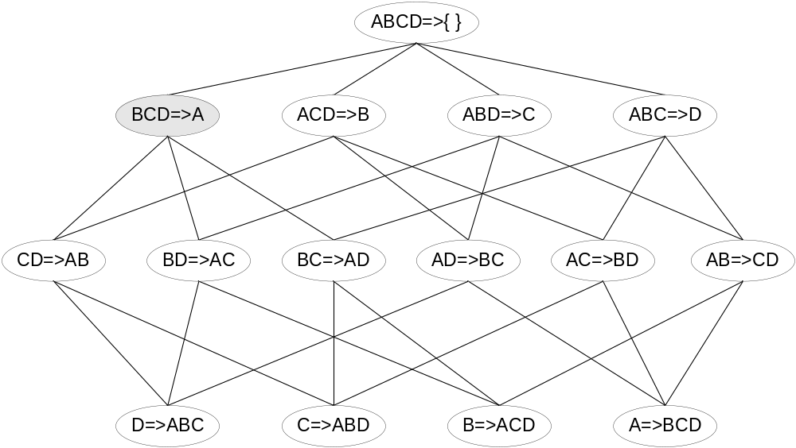

Rule Generation for Apriori Algorithm
Lattice of rules
Low Confidence Rule
Pruned Rules
Data Mining

Slide 63
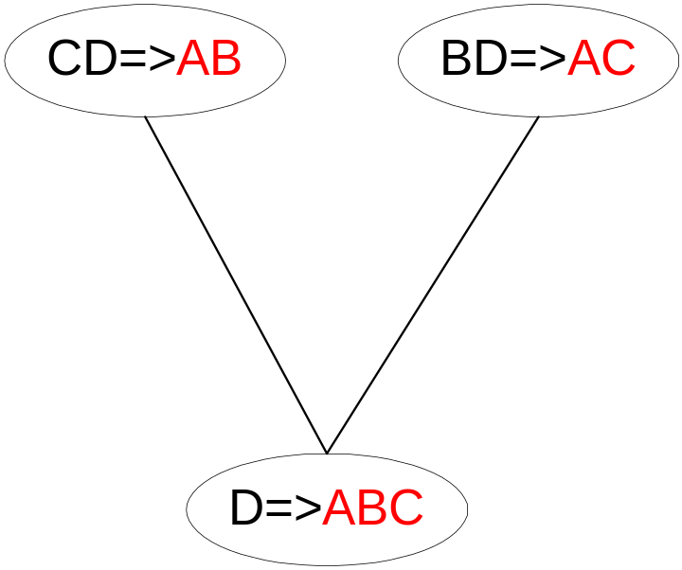
Rule Generation for Apriori Algorithm
Candidate rule is generated by merging two rules that share the same prefix
in the rule consequent
join(CD=>AB,BD=>AC)
would produce the candidate
rule D => ABC
Prune rule D=>ABC if its
subset AD=>BC does not have
high confidence
Data Mining

Slide 64
Interestingness Measurements
Objective measures
  Two popular measurements:
  support; and
  Confidence
Data Mining

Slide 65
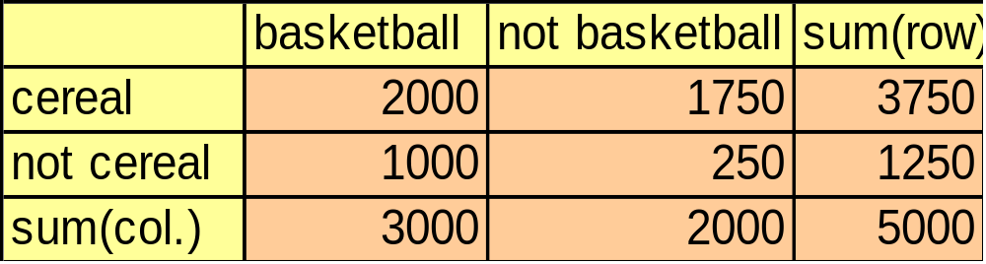
Criticism to Support and Confidence
Example 1:
  Among 5000 students
    3000 play basketball
    3750 eat cereal
    2000 both play basket ball and eat cereal
  play basketball ⇒ eat cereal [40%, 66.7%] is misleading because the overall percentage of students eating cereal is 75% which is higher than 66.7%.
  play basketball ⇒ not eat cereal [20%, 33.3%] is far more accurate, although with lower support and confidence
Data Mining

Slide 66
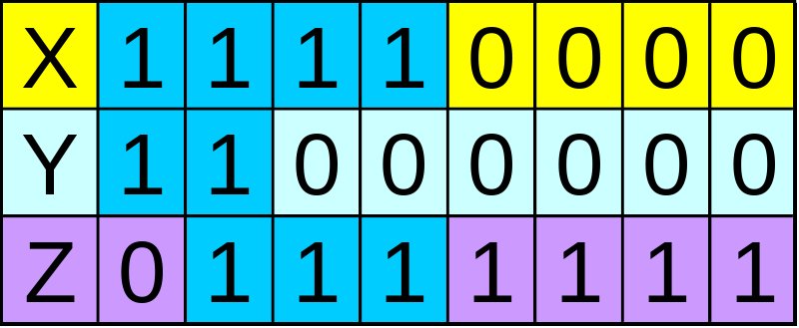
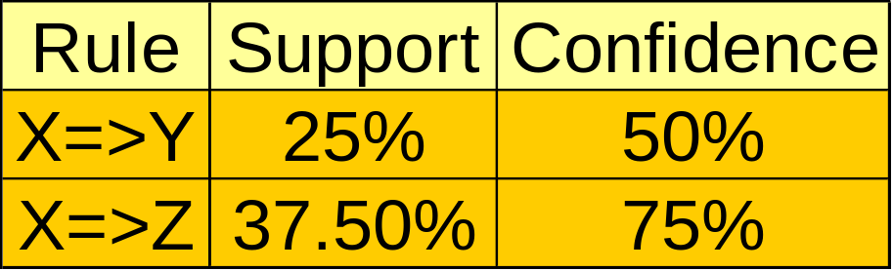
Criticism to Support and Confidence (Cont.)
Example 2:
  X and Y: positively correlated,
  X and Z, negatively related
  support and confidence of
  X=>Z dominates
We need a measure of dependent or correlated events
P(B|A)/P(B) is also called the lift of rule A => B
Data Mining

Slide 67
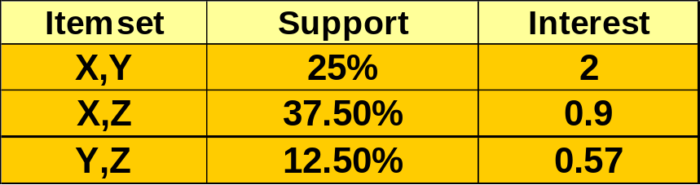
Association Rule LIFT
The lift of an association rule I => J is defined as:
  lift = P(J|I) / P(J)
  Note, P(I) = (support of I) / (no. of transactions)
Interpretation:
  if lift > 1, then I and J are positively correlated
lift < 1, then I are J are negatively correlated.
lift = 1, then I and J are independent.
Data Mining

Slide 68
Importance in SQL
Importance ({A,B}) = Probability (A, B)/(Probability (A)* Probability (B))
If importance = 1, A and B are independent items. It means that the
purchase of product A and the purchase of product B are two independent
events. If importance < 1, A and B are negatively correlated, which means that if a customer buys A, it is unlikely he or she will also buy B. If importance > 1, A and B are positively correlated, which means that if a customer buys A, it is very likely he or she also buys B.
Importance ({X,Y}) = Probability (X, Y)/(Probability (X)* Probability (Y))
= 2/8 / (4/8 * 2/ 8)
= 2
Data Mining

Slide 69
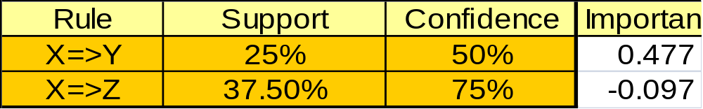
Importance in SQL for Rules
Importance (A => B) = log (p(B|A) / p(B|not A) )
An importance of 0 means that there is no association between A and B. A
positive importance score means that the probability of B goes up when A is
true. A negative importance score means that the probability of B goes down
when A is true.
Data Mining

Slide 70
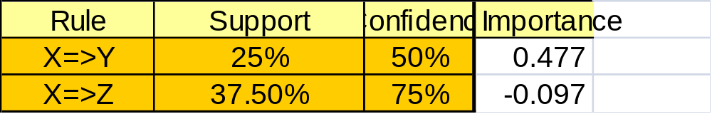
Importance in SQL for Rules
Importance (A => B) = log (p(B|A)/p(B|not A))
Importance(X => Y) = log (3/5 / 1/5) = 0.477
Importance(X => Z) = log (4/5 / 5/5 ) = -0.097
Data Mining

Slide 71
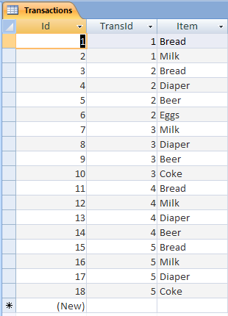
SQL Example
Data Mining

Slide 72
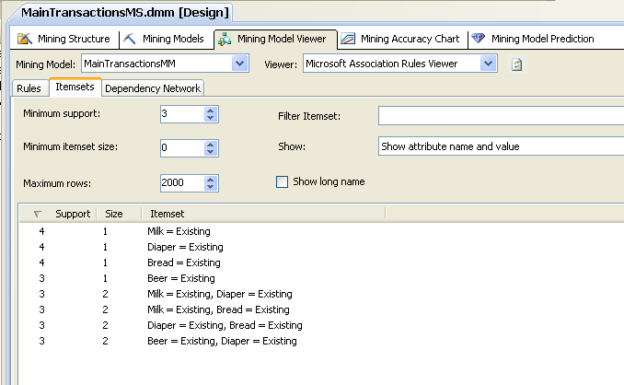
SQL Example
Data Mining

Slide 73
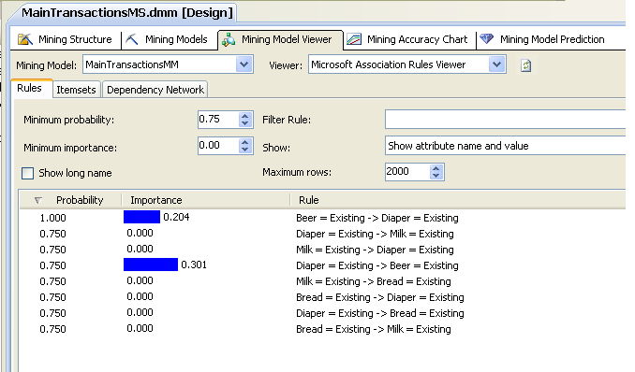
SQL Example
Data Mining

Slide 74
SQL Example
 | Beer | Not Beer | Total
Diaper | 3 | 1 | 4
not Diaper | 0 | 1 | 1
Total | 3 | 2 | 5
Support(Beer) = 3
Support(Diaper) = 4
Support(Beer, Diaper) = 3
Probability(Diaper) = 4/5
Probability(Beer) = 3/5
Probability(Beer, Diaper) = 3/5
Probability(Beer|Diaper) = 3/4
Probability(Diaper|Beer) =3/3
Imprtance(Beer, Diaper) = 3/5 (4/5 * 3/5) = 0.288
Data Mining

Slide 75
SQL Example
 | Beer | Not Beer | Total
Diaper | 3 + 1 | 1 + 1 | 6
not Diaper | 0 + 1 | 1 + 1 | 3
Total | 5 | 4 | 9
Importance(Beer ⇒ Diaper) =
Log 10 ( P(Diaper | Beer) / P(Diaper | not Beer) )
Log10 ( 4/5 / 2/4) = 0.204
Importance(Diaper ⇒ Beer) =
Log10 ( P(Beer | Diaper) / P(Beer | not Diaper) )
= Log10( 4/6 / 1/3 ) = 0.301
Data Mining

Slide 76
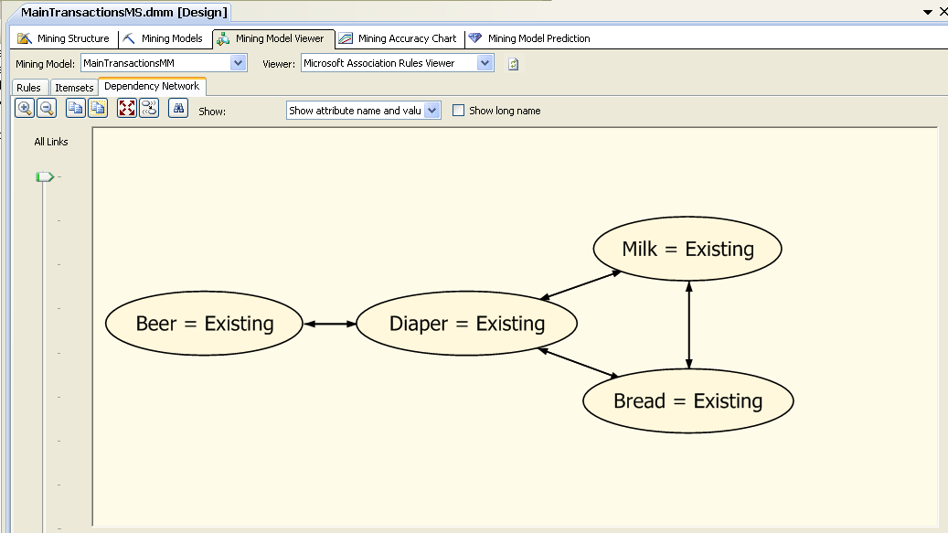
SQL Example
Data Mining

Slide 77
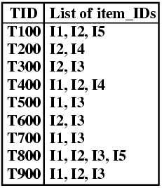
Exercise
min-sup = 20%
min-conf = 80%
Data Mining

Slide 78
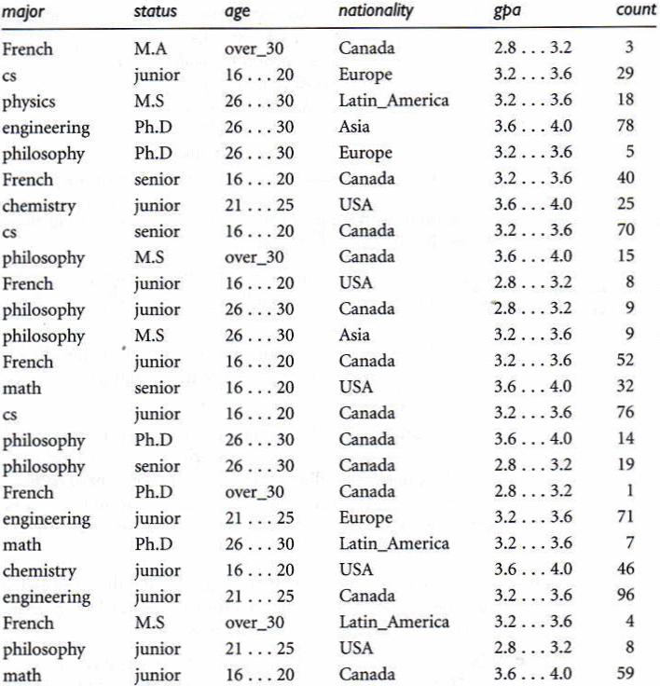
Exercise
min-sup = 20%
min-conf = 80%
Data Mining

Slide 79
Sequential pattern mining
Data Mining

Slide 80
Sequence Databases and Sequential Pattern Analysis
Applications of sequential pattern mining
  Customer shopping sequences:
    First buy computer, then CD-ROM, and then digital camera, within 3 months.
  Medical treatment, natural disasters (e.g., earthquakes), science & engineering processes, stocks and markets, etc.
  Weblog click streams
  DNA sequences and gene structures
Data Mining

Slide 81
What Is Sequential Pattern Mining?
Given a set of sequences, find the complete set of frequent subsequences
A sequence : < (ef) (ab) (df) c b >
A sequence database
SID | sequence
10 | <a(abc)(ac)d(cf)>
20 | <(ad)c(bc)(ae)>
30 | <(ef)(ab)(df)cb>
40 | <eg(af)cbc>
An element may contain a set of items.
Items within an element are unordered
and we list them alphabetically.
<a(bc)dc> is a subsequence of <a(abc)(ac)d(cf)>
Given support threshold min_sup =2, <(ab)c> is a sequential pattern
Data Mining

Slide 82
Challenges on Sequential Pattern Mining
A huge number of possible sequential patterns are hidden in databases
A mining algorithm should
  find the complete set of patterns, when possible, satisfying the minimum support (frequency) threshold
  be highly efficient, scalable, involving only a small number of database scans
  be able to incorporate various kinds of user-specific constraints
Data Mining

Slide 83
A Basic Property of Sequential Patterns: Apriori
A basic property: Apriori
  If a sequence S is not frequent
  Then none of the super-sequences of S is frequent
  E.g, <hb> is infrequent → so do <hab> and <(ah)b>
Seq. ID
Sequence
Given support threshold min_sup =2
10
<(bd)cb(ac)>
20
<(bf)(ce)b(fg)>
30
<(ah)(bf)abf>
40
<(be)(ce)d>
50
<a(bd)bcb(ade)>
Data Mining

Slide 84
GSP—A Generalized Sequential Pattern Mining Algorithm
Outline of the method
  Initially, every item in DB is a candidate of length-1
  for each level (i.e., sequences of length-k) do
    scan database to collect support count for each candidate sequence
    generate candidate length-(k+1) sequences from length-k frequent sequences using Apriori
  repeat until no frequent sequence or no candidate can be found
Major strength: Candidate pruning by Apriori
Data Mining

Slide 85
Finding Length-1 Sequential Patterns
Examine GSP using an example
Initial candidates: all singleton sequences
  <a>, <b>, <c>, <d>, <e>, <f>, <g>, <h>
Scan database once, count support for candidates
Cand | Sup
<a> | 3
<b> | 5
<c> | 4
<d> | 3
<e> | 3
<f> | 2
<g> | 1
<h> | 1
min_sup =2
Seq. ID
Sequence
10
<(bd)cb(ac)>
20
<(bf)(ce)b(fg)>
30
<(ah)(bf)abf>
40
<(be)(ce)d>
50
<a(bd)bcb(ade)>
Data Mining

Slide 86
Generating Length-2 Candidates
 | <a> | <b> | <c> | <d> | <e> | <f>
<a> | <aa> | <ab> | <ac> | <ad> | <ae> | <af>
<b> | <ba> | <bb> | <bc> | <bd> | <be> | <bf>
<c> | <ca> | <cb> | <cc> | <cd> | <ce> | <cf>
<d> | <da> | <db> | <dc> | <dd> | <de> | <df>
<e> | <ea> | <eb> | <ec> | <ed> | <ee> | <ef>
<f> | <fa> | <fb> | <fc> | <fd> | <fe> | <ff>
51 length-2
Candidates
 | <a> | <b> | <c> | <d> | <e> | <f>
<a> |  | <(ab)> | <(ac)> | <(ad)> | <(ae)> | <(af)>
<b> |  |  | <(bc)> | <(bd)> | <(be)> | <(bf)>
<c> |  |  |  | <(cd)> | <(ce)> | <(cf)>
<d> |  |  |  |  | <(de)> | <(df)>
<e> |  |  |  |  |  | <(ef)>
<f>
Without Apriori property,
8*8+8*7/2=92 candidates
Apriori prunes
44.57% candidates
Data Mining

Slide 87
Finding Length-2 Sequential Patterns
Scan database one more time, collect support count for each length-2 candidate
There are 19 length-2 candidates which pass the minimum support threshold
  They are length-2 sequential patterns
Data Mining

Slide 88
Generating Length-3 Candidates and Finding Length-3 Patterns
Generate Length-3 Candidates
  Self-join length-2 sequential patterns
    Based on the Apriori property
    <ab>, <aa> and <ba> are all length-2 sequential patterns → <aba> is a length-3 candidate
    <(bd)>, <bb> and <db> are all length-2 sequential patterns → <(bd)b> is a length-3 candidate
  46 candidates are generated
Find Length-3 Sequential Patterns
  Scan database once more, collect support counts for candidates
  19 out of 46 candidates pass support threshold
Data Mining

Slide 89
The GSP Mining Process
5th scan: 1 cand. 1 length-5 seq. pat.
<(bd)cba>
Cand. cannot pass sup. threshold
4th scan: 8 cand. 6 length-4 seq. pat.
<abba> <(bd)bc> …
Cand. not in DB at all
3rd scan: 46 cand. 19 length-3 seq. pat. 20 cand. not in DB at all
<abb> <aab> <aba> <baa> <bab> …
2nd scan: 51 cand. 19 length-2 seq. pat. 10 cand. not in DB at all
<aa> <ab> … <af> <ba> <bb> … <ff> <(ab)> … <(ef)>
1st scan: 8 cand. 6 length-1 seq. pat.
<a> <b> <c> <d> <e> <f> <g> <h>
Seq. ID
Sequence
min_sup =2
10
<(bd)cb(ac)>
20
<(bf)(ce)b(fg)>
30
<(ah)(bf)abf>
40
<(be)(ce)d>
50
<a(bd)bcb(ade)>

Slide 90
The GSP Algorithm
Take sequences in form of <x> as length-1 candidates
Scan database once, find F₁, the set of length-1 sequential patterns
Let k=1; while F_{k} is not empty do
  Form C_{k+1}, the set of length-(k+1) candidates from F_{k};
  If C_{k+1} is not empty, scan database once, find F_{k+1}, the set of length-(k+1) sequential patterns
  Let k=k+1;
Data Mining

Slide 91
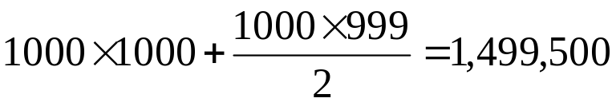
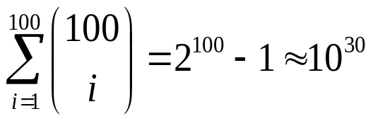
Bottlenecks of GSP
A huge set of candidates could be generated
  1,000 frequent length-1 sequences generate length-2 candidates!
Multiple scans of database in mining
Real challenge: mining long sequential patterns
  An exponential number of short candidates
  A length-100 sequential pattern needs 10³⁰ candidate sequences!
Data Mining

Slide 92
PrefixSpan Algorithm
<a>, <aa>, <a(ab)> and <a(abc)> are prefixes of sequence <a(abc)(ac)d(cf)>
Given sequence <a(abc)(ac)d(cf)>
Prefix | Suffix (Prefix-Based Projection)
<a> | <(abc)(ac)d(cf)>
<aa> | <(_bc)(ac)d(cf)>
<ab> | <(_c)(ac)d(cf)>
Data Mining

Slide 93
Mining Sequential Patterns by Prefix Projections
Step 1: find length-1 sequential patterns
  <a>, <b>, <c>, <d>, <e>, <f>
Step 2: divide search space. The complete set of seq. pat. can be partitioned into 6 subsets:
  The ones having prefix <a>;
  The ones having prefix <b>;
  …
  The ones having prefix <f>
SID | sequence
10 | <a(abc)(ac)d(cf)>
20 | <(ad)c(bc)(ae)>
30 | <(ef)(ab)(df)cb>
40 | <eg(af)cbc>
Data Mining

Slide 94
Finding Seq. Patterns with Prefix <a>
Only need to consider projections w.r.t. <a>
  <a>-projected database: <(abc)(ac)d(cf)>, <(_d)c(bc)(ae)>, <(_b)(df)cb>, <(_f)cbc>
Find all the length-2 seq. pat. Having prefix <a>: <aa>, <ab>, <(ab)>, <ac>, <ad>, <af>
  Further partition into 6 subsets
    Having prefix <aa>;
    …
    Having prefix <af>
SID | sequence
10 | <a(abc)(ac)d(cf)>
20 | <(ad)c(bc)(ae)>
30 | <(ef)(ab)(df)cb>
40 | <eg(af)cbc>
Data Mining

Slide 95
Completeness of PrefixSpan
SDB
SID | sequence
10 | <a(abc)(ac)d(cf)>
20 | <(ad)c(bc)(ae)>
30 | <(ef)(ab)(df)cb>
40 | <eg(af)cbc>
Length-1 sequential patterns
<a>, <b>, <c>, <d>, <e>, <f>
Having prefix <a>
Having prefix <c>, …, <f>
Having prefix <b>
<a>-projected database
<(abc)(ac)d(cf)>
<(_d)c(bc)(ae)>
<(_b)(df)cb>
<(_f)cbc>
<b>-projected database
…
Length-2 sequential
patterns
<aa>, <ab>, <(ab)>,
<ac>, <ad>, <af>
… …
Having prefix <aa>
Having prefix <af>
<aa>-proj. db
…
<af>-proj. db
Data Mining

Slide 96
Efficiency of PrefixSpan
No candidate sequence needs to be generated
Projected databases keep shrinking
Major cost of PrefixSpan: constructing projected databases
  Can be improved by bi-level projections
Data Mining

Slide 97
Example
Sequence_id | Sequence | Projected(suffix) databases
10 | <a(abc)(ac)d(cf)> | <a(abc)(ac)d(cf)>
20 | <(ad)c(bc)(ae)> | <(ad)c(bc)(ae)>
30 | <(ef)(ab)(df)cb> | <(ef)(ab)(df)cb>
40 | <eg(af)cbc> | <eg(af)cbc>
Prefix | Projected(suffix) databases | Sequential Patterns
<a> | <(abc)(ac)d(cf)>, <(_d)c(bc)(ae)>, <(_b)(df)cb>, <(_f)cbc> | <a>,<aa>,<ab><a(bc)>,<a(bc)a>,<aba>,<abc>,<(ab)>,<(ab)c>,<(ab)d>,<(ab)f>,<(ab)dc>,<ac>,<aca>,<acb>,<acc>,<ad>,<adc>,<af>
Data Mining

Slide 98
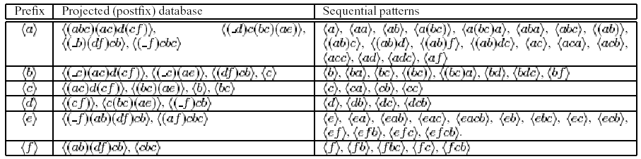
Example
Sequence_id | Sequence
10 | <a(abc)(ac)d(cf)>
20 | <(ad)c(bc)(ae)>
30 | <(ef)(ab)(df)cb>
40 | <eg(af)cbc>
Data Mining

Slide 99
PrefixSpan (the example to be continued)
Step1: Find length-1 sequential patterns;
<a>:4, <b>:4, <c>:4, <d>:3, <e>:3, <f>:3
support
pattern
Step2: Divide search space;
six subsets according to the six prefixes;
Step3: Find subsets of sequential patterns;
By constructing corresponding projected databases and mine
each recursively.
Data Mining

Slide 100
Prefix | Projected(suffix) databases | Sequential Patterns
<a> | <(abc)(ac)d(cf)>, <(_d)c(bc)(ae)>, <(_b)(df)cb>, <(_f)cbc> | <a>,<aa>,<ab><a(bc)>,<a(bc)a>,<aba>,<abc>,<(ab)>,<(ab)c>,<(ab)d>,<(ab)f>,<(ab)dc>,<ac>,<aca>,<acb>,<acc>,<ad>,<adc>,<af>
Find sequential patterns having prefix <a>:
  Scan sequence database S once. Sequences in S containing <a> are projected w.r.t <a> to form the <a>-projected database.
  Scan <a>-projected database once, get six length-2 sequential patterns having prefix <a> :
  <a>:2 , <b>:4, <(_b)>:2, <c>:4, <d>:2, <f>:2
  <aa>:2 , <ab>:4, <(ab)>:2, <ac>:4, <ad>:2, <af>:2
  Recursively, all sequential patterns having prefix <a> can be further partitioned into 6 subsets. Construct respective projected databases and mine each.
  e.g. <aa>-projected database has two sequences :
  <(_bc)(ac)d(cf)> and <(_e)>.
Data Mining

Slide 101
PrefixSpan Algorithm
Main Idea: Use frequent prefixes to divide the search space and to project sequence databases. only search the relevant sequences.
PrefixSpan(α, i, S|α)
Scan S|α once, find the set of frequent items b such that
  b can be assembled to the last element of α to form a sequential pattern; or
  <b> can be appended to α to form a sequential pattern.
For each frequent item b, appended it to α to form a sequential pattern α’, and output α’;
For each α’, construct α’-projected database S|α’, and call PrefixSpan(α’, i+1,S|α’).
Data Mining

